Slide 1
Ubuntu 20.04
Gnome and Mate - Desktop
Waikato Linux Users Group
25 May 2020
Ian Stewart

Slide 2
Ubuntu 20.04 ~ History
First released in Oct 2004.
33 Releases
6 Monthly releases April and October.
LTS every two years. 16.04, 18.04, 20.04
Normal Support 5 years
Extended Security Maintenance 10 years.
Server edition plus 8 desktop flavours
Default desktop since Oct 2017 – Gnome3
Mate desktop flavour since April 2014

Slide 3
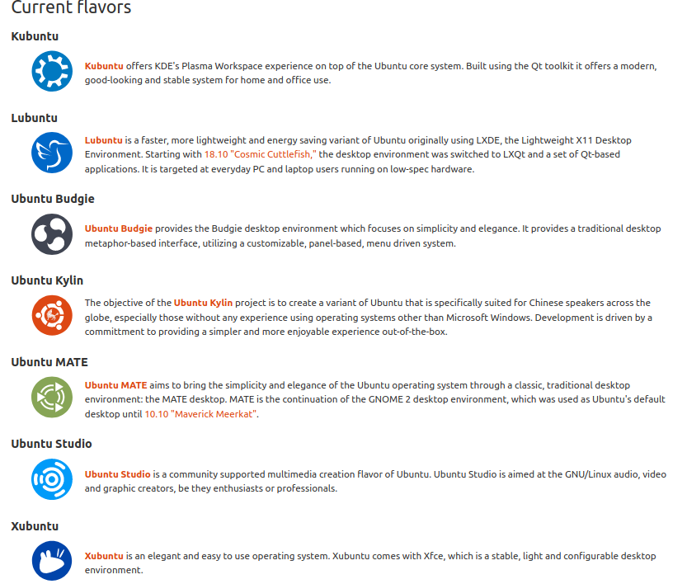
Ubuntu 20.04 ~ Flavours
As well as Server and default Gnome desktop

Slide 4
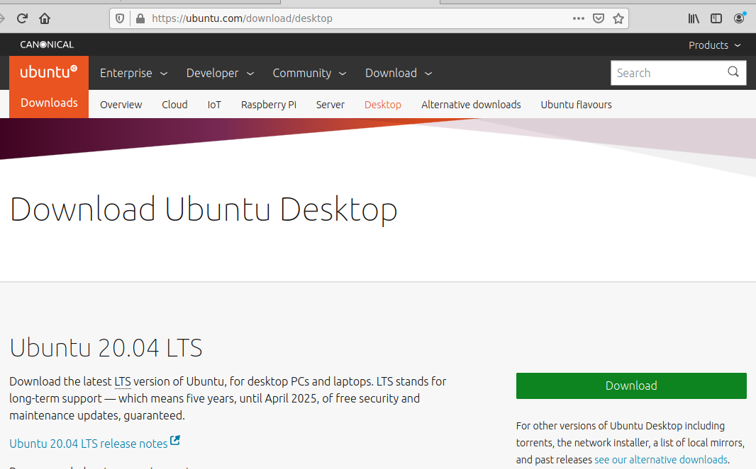
Ubuntu 20.04 ~ Default Desktop Download
https://ubuntu.com/download/desktop

Slide 5
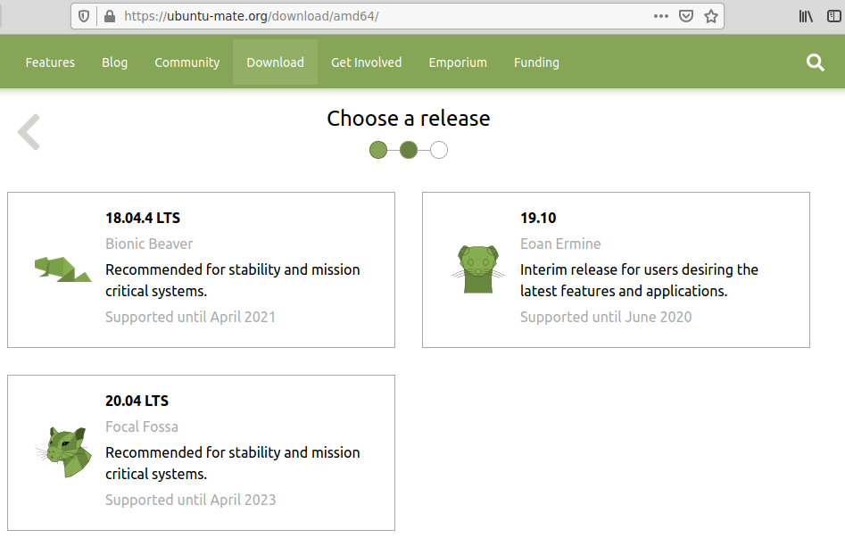
Ubuntu 20.04 ~ Mate download
https://ubuntu-mate.org/downloads/amd64/

Slide 6
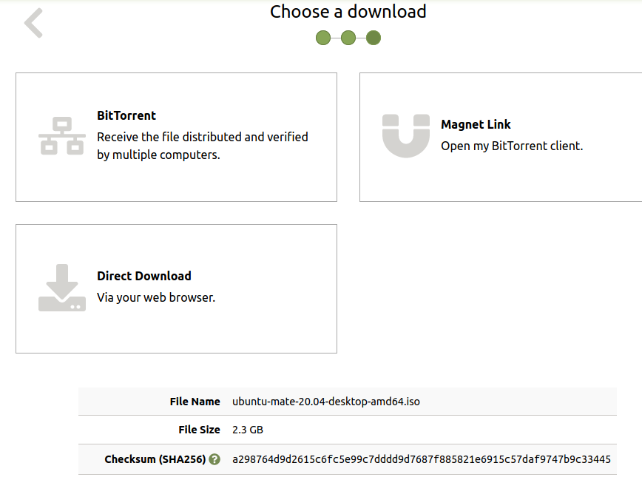
Ubuntu 20.04 ~ Mate. 2.3GB iso file.
test

Slide 7
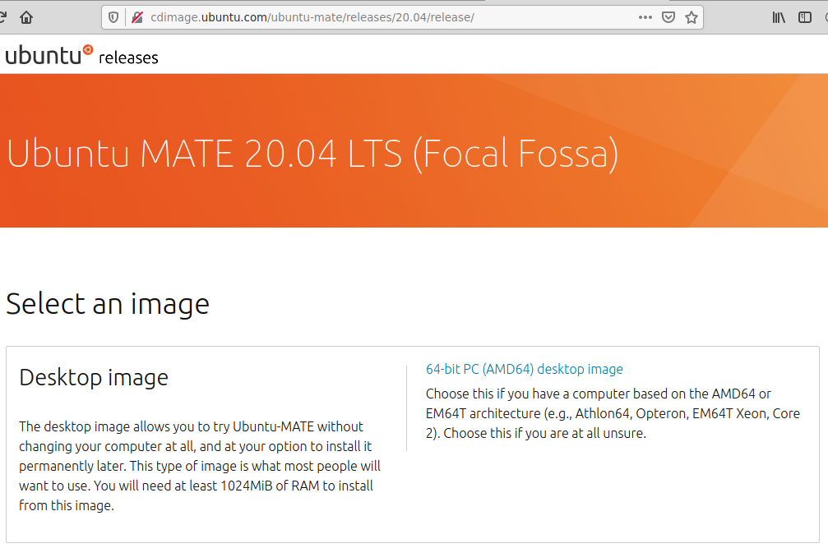
Ubuntu 20.04 ~ cdimage repository
http://cdimage.ubuntu.com/ubuntu-mate/releases/20.04/release/

Slide 8
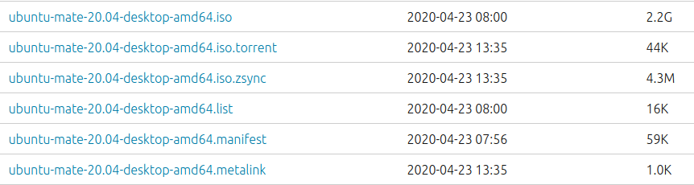
Ubuntu 20.04 ~ cdimage repository
http://cdimage.ubuntu.com/ubuntu-mate/releases/20.04/release/

Slide 9
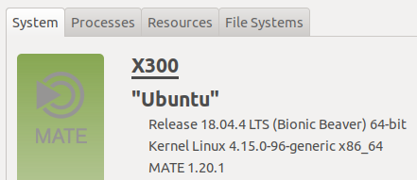
Ubuntu 20.04 ~ Online upgrade from 18.04 or 19.10

Slide 10
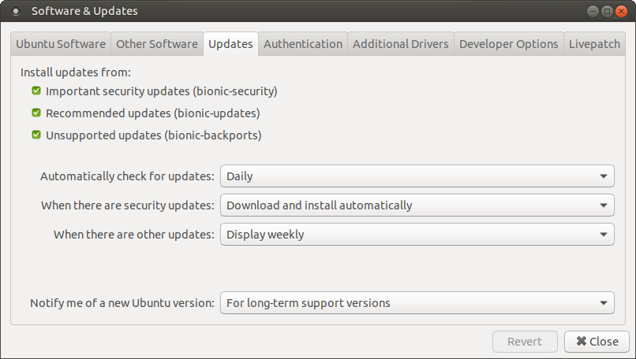
Ubuntu 20.04 ~ Notification once 20.04.1 released

Slide 11
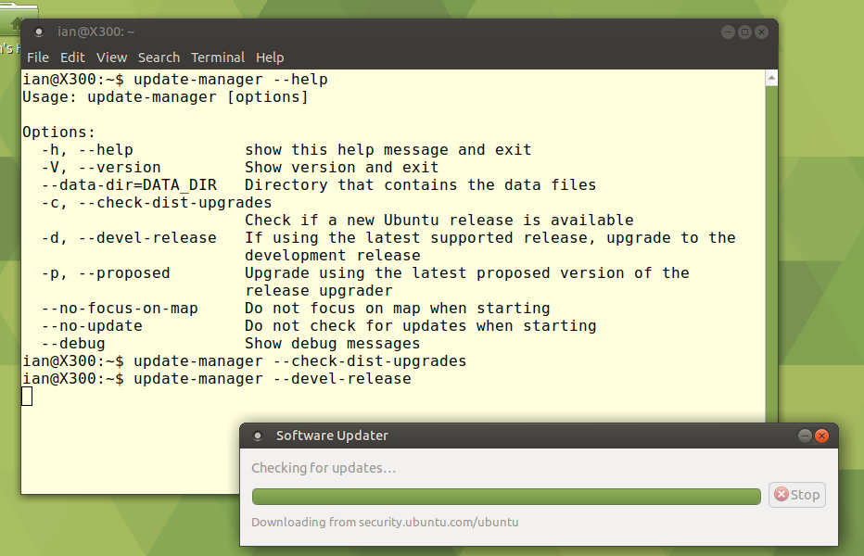
Ubuntu 20.04 ~ Try update-manager

Slide 12
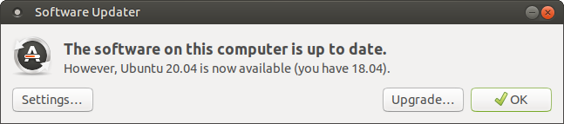
Ubuntu 20.04 ~ Notification message

Slide 13
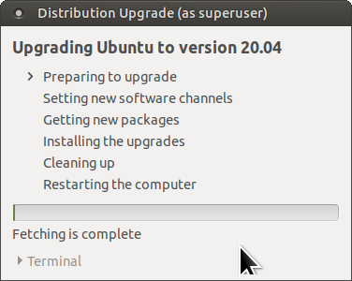
Ubuntu 20.04 ~ Upgrading to 20.04

Slide 14
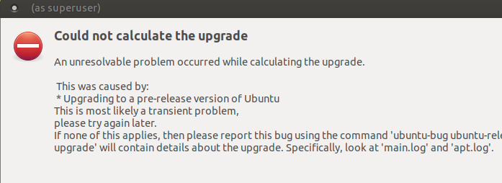
Ubuntu 20.04 ~ Oops not going to plan

Slide 15
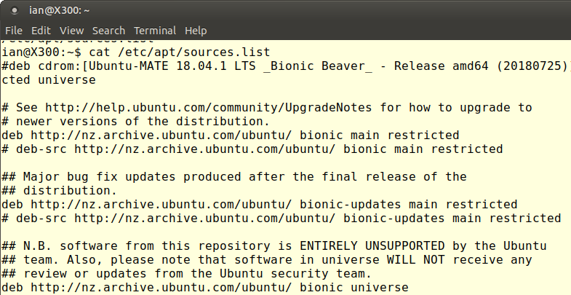
Ubuntu 20.04 ~ Upgrading the Debian way

Slide 16
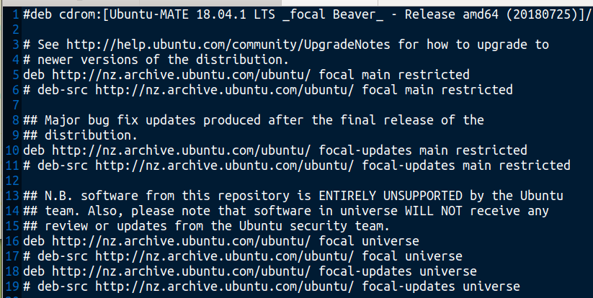
Ubuntu 20.04 ~ Change bionic to focal

Slide 17
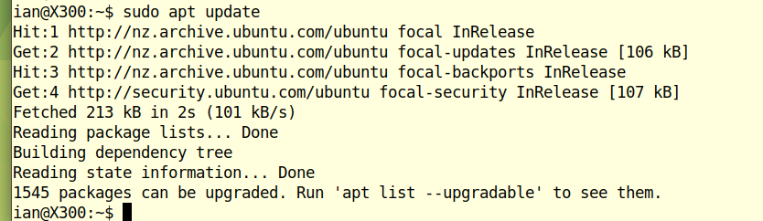
Ubuntu 20.04 ~ Getting ready to update

Slide 18
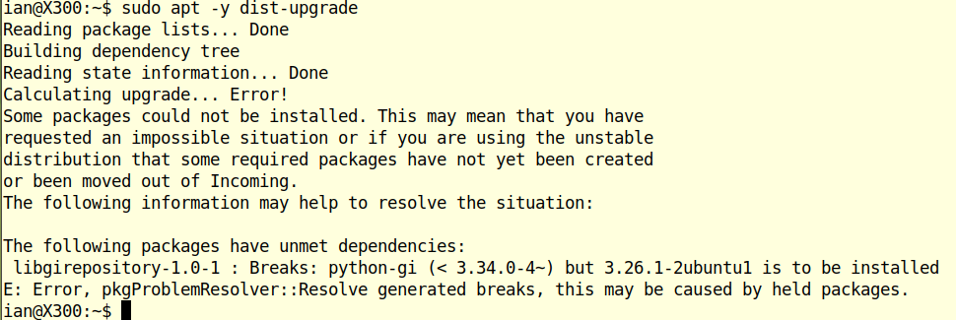
Ubuntu 20.04 ~ Almost...

Slide 19
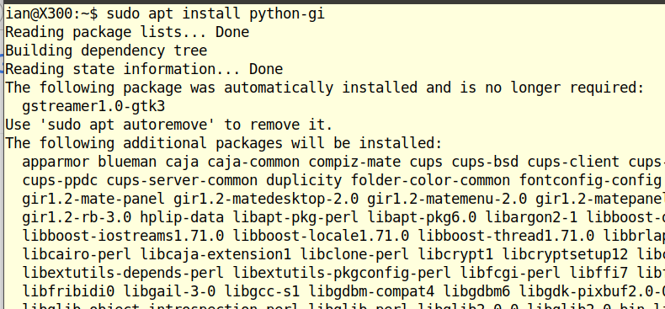
Ubuntu 20.04 ~ Almost...

Slide 20
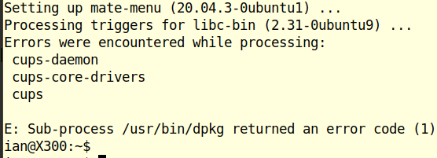
Ubuntu 20.04 ~

Slide 21
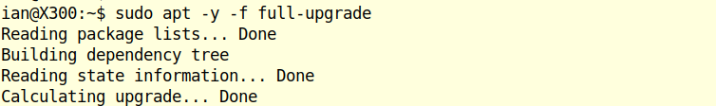

Ubuntu 20.04 ~

Slide 22
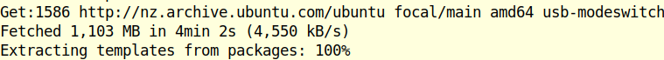
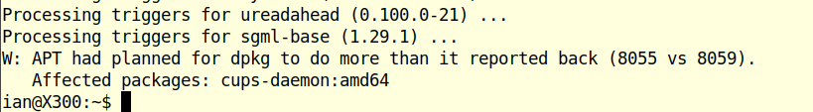
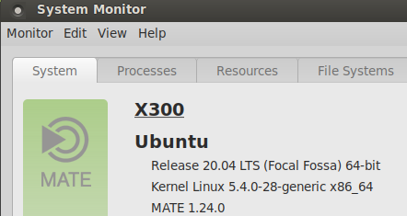
Ubuntu 20.04 ~ Complete upgade and reboot.

Slide 23
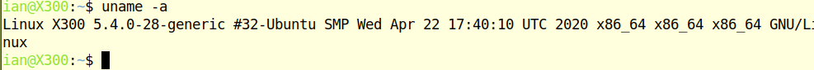

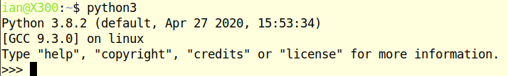
Ubuntu 20.04 ~ Looking around

Slide 24
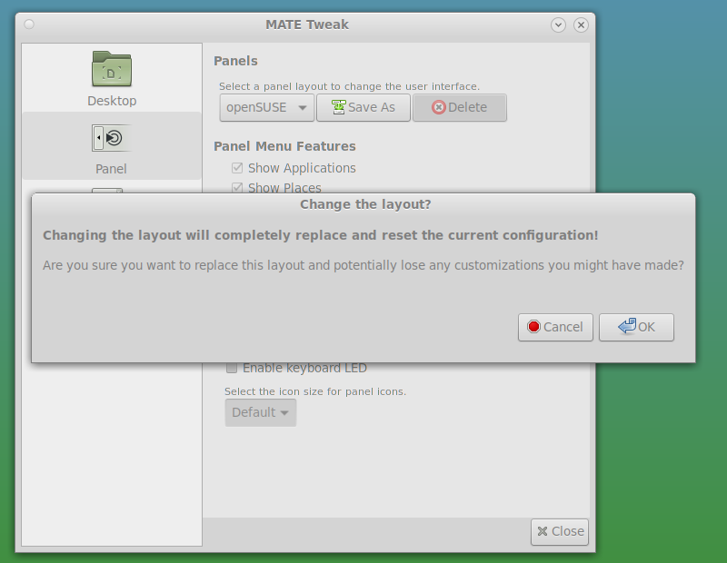
Ubuntu 20.04 ~ Weird Stuff

Slide 25
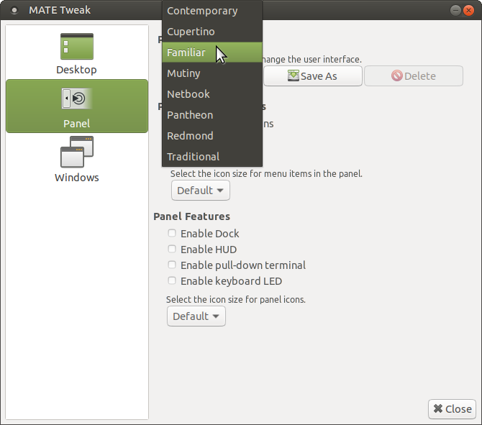
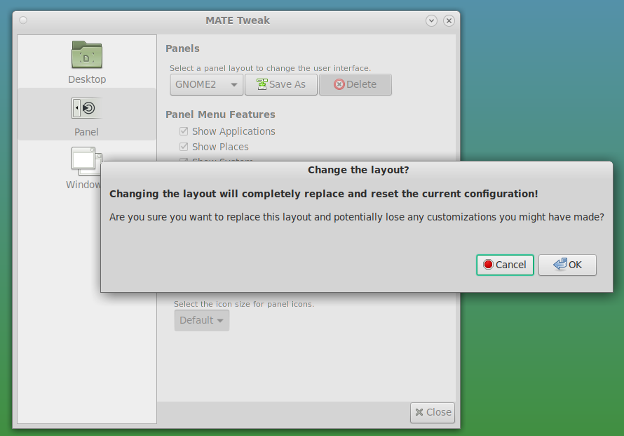
Ubuntu 20.04 ~ Weird Stuff
o

Slide 26
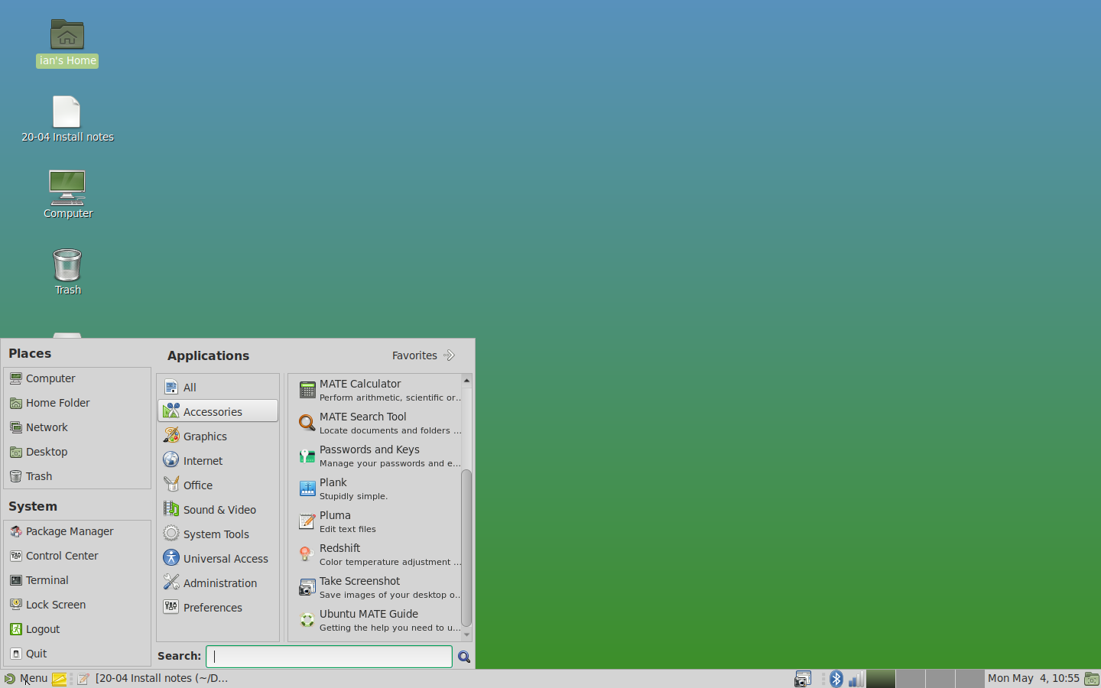

Ubuntu 20.04 ~ Weird Stuff

Slide 27
Ubuntu 20.04 ~ USB install observations
Download iso, copy to USB Stick, boot USB stick
Checks data integrity on the USB stick on booting stick
After finishes needs 30 ~ 40 patch kits. Include cups
Linux from 5.4.0.26 to 5.4.0.28
Mate defaults to one “Menu” icon on system menu tray
Has Control centre with Mate tweak Familiar/Traditional
Python 3.8.2

Slide 28
Ubuntu 20.04 ~ Mate – New Features - Highlights
https://ubuntu-mate.org/blog/ubuntu-mate-focal-fossa-release-notes/
Control Centre – Welcome – Colour Selection
Mate 1.24.0 (previously 1.20)
Python2 not installed. Python-is-python3 app
Firmware updater - a GTK front end for fwupd
Invisible window corners - windows easily resized
Mate Tweak – Panel Switching bug fixed
Two network status icons being displayed is fixed.
MATE Window Applets received a number of bug fixes
Indicator that provides a “notification center”
Evolution replaces Thunderbird
Date/Time integrates with Evolution. No seconds?
Celluloid GTK front-end for MPV

Slide 29
Ubuntu 20.04 ~ Mate – New Features - Highlights
https://wiki.ubuntu.com/FocalFossa/ReleaseNotes
Linux 5.4 Built in support for the WireGuard VPN.
glibc 2.31 OpenJDK 11 rustc 1.41 GCC 9.3 🐍 Python 3.8.2
Mesa 20.0 OpenGL stack
BlueZ 5.53
Thunderbird 68.7.0
LibreOffice 6.4
Dock. Can disable it completely.

Slide 30
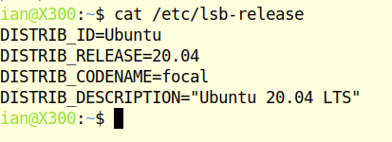
Ubuntu 20.04 ~ Questions and Demos

